Slide 1
Optimized Wi-Fi based Control System for Pond Aerators in Shrimp Farming
Guide:- Ms. Anagha Patil
Tushar Mittal (37)
Dhruvil Mehta (36)
Shreyas Manoti (35)

Slide 2
TABLE OF CONTENTS
01
03
02
04
INTRODUCTION
Literature Survey
Problem Statement
Proposed Implementation

Slide 3
INTRODUCTION

Slide 4
Shrimp Farming
Shrimp farming is an aquaculture business that exists in either a marine or freshwater environment, producing shrimp or prawns

Slide 5
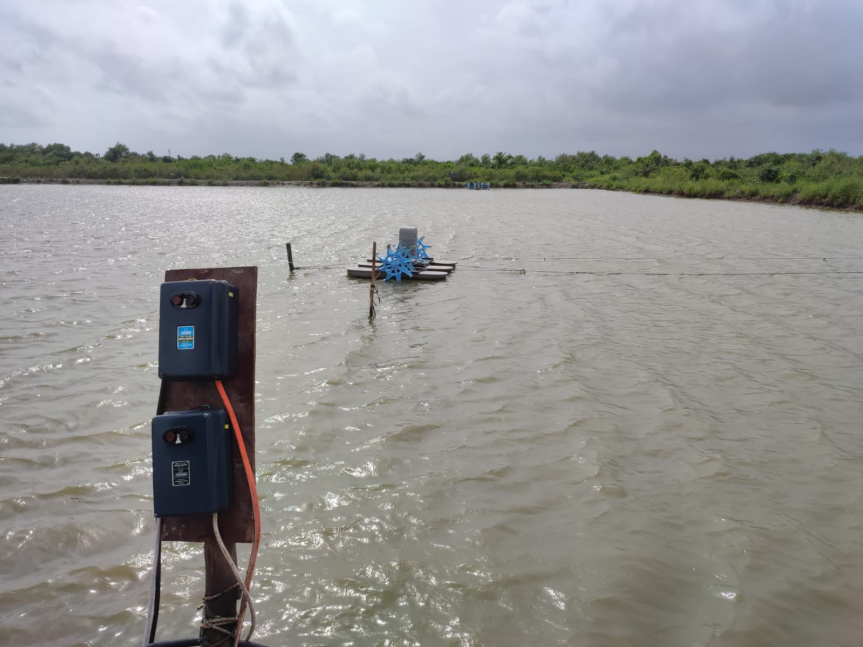

Slide 6
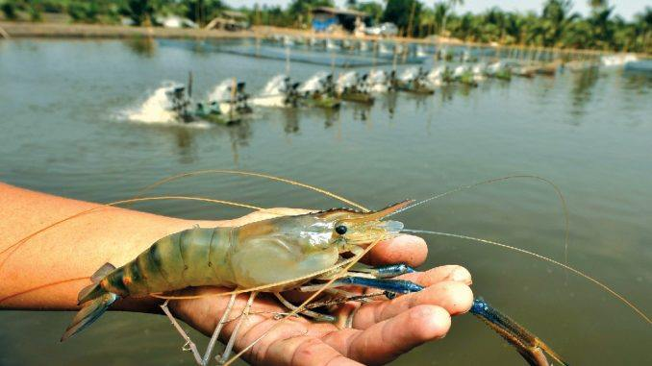

Slide 7
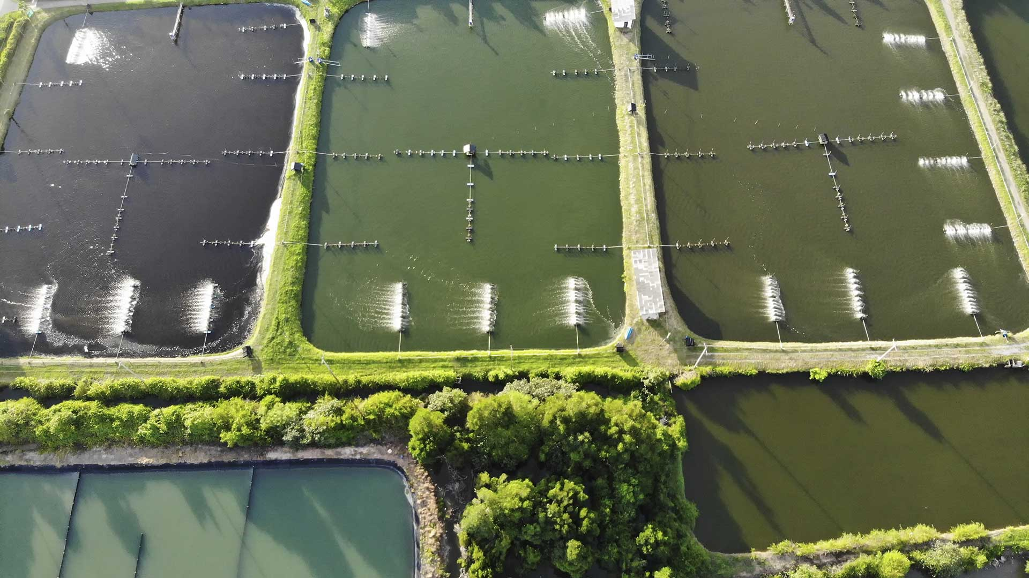

Slide 8
01
02
03
What is an Aerator?
Aerators are various mechanical devices used for aeration, or mixing air with another substance, such as soil or water. These devices are mainly used to add oxygen to the water.
An aerated pond will be clearer, cleaner, and have less bottom muck than a pond without aeration. A pond without aeration will become stratified into two very separate layers in the summer heat.
Water aeration is the process of increasing or maintaining the oxygen saturation of water in both natural and artificial environments. Aeration techniques are commonly used in pond, lake, and reservoir management to address low oxygen levels or algal blooms

Slide 9
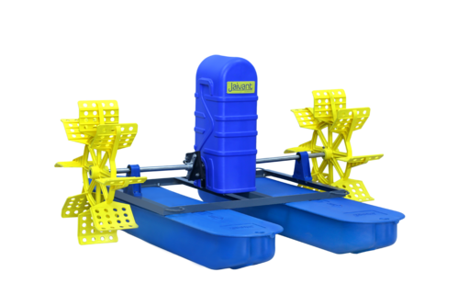

Slide 10
01
02
03
What is a Motor Starter?
A DOL starter (also known as a direct on line starter or across the line starter) is a method of starting a 3 phase induction motor.
In a DOL Starter, an induction motor is connected directly across its 3-phase supply, and the DOL starter applies the full line voltage to the motor terminals.
In this method, the starter is connected directly to supply voltage. By this method, small motors up to 5 kW rating are started to avoid the supply voltage fluctuation.

Slide 11
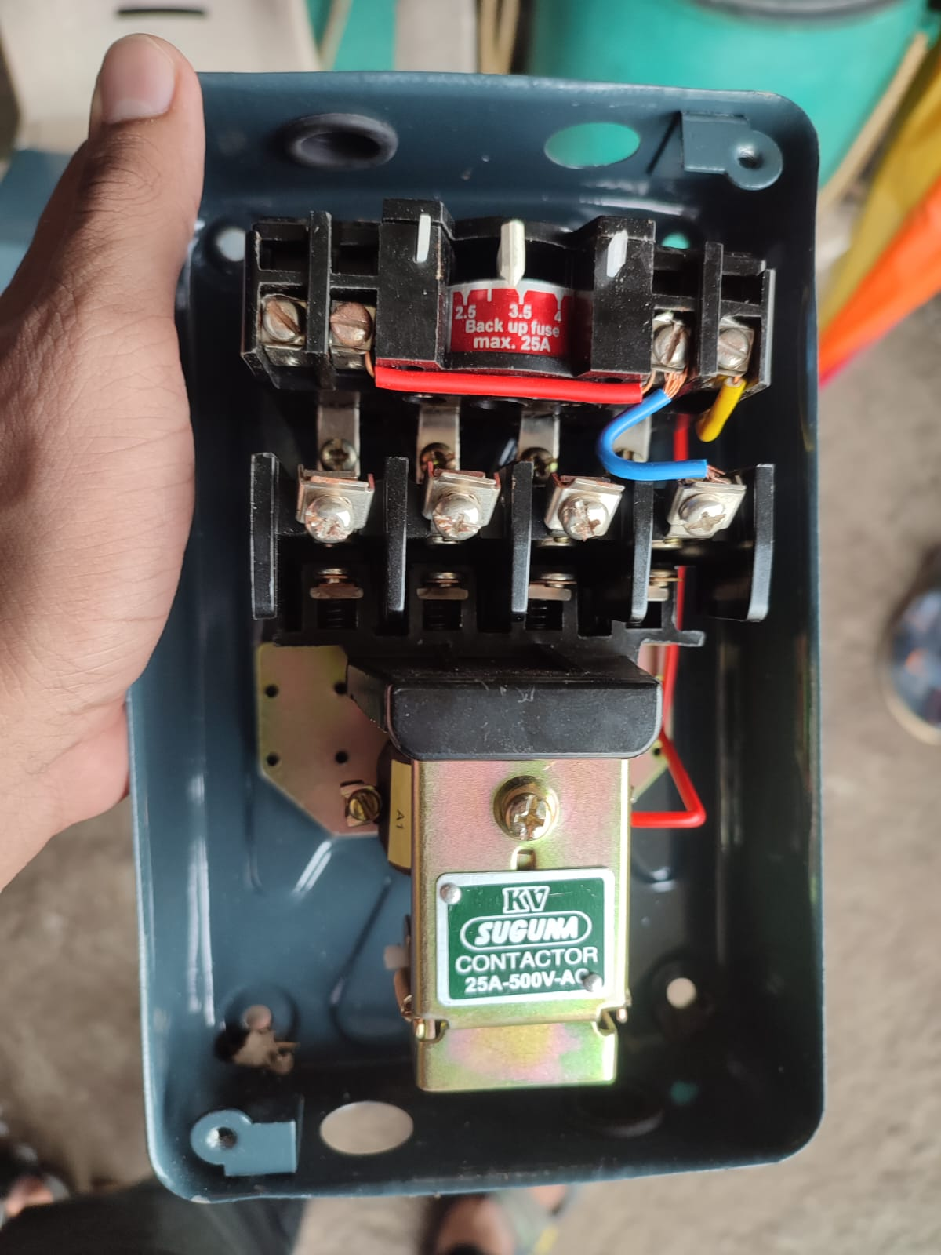

Slide 12
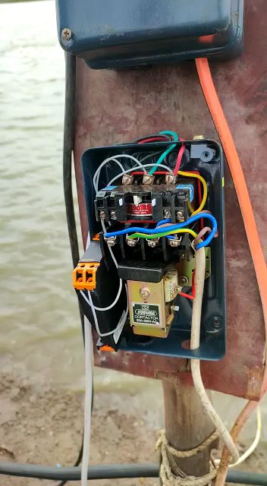

Slide 13
01
02
03
Problem Statement
As we have seen, in any aqua farming or shrimp farming, an Aerator and a DOL starter plays a crucial role.
The Problem arises when in a huge aqua farm like Shrimp Farming the area is huge. This causes the problem for the workers of having to manually start each and every DOL Motor Starter to turn on the Aerators every day.
This becomes a tussle as the area is vast and these starters have to be switched ON and OFF timely as to maintain proper health of the Shrimps.

Slide 14
01
02
03
Problem Statement
Our Goal is to find appropriate solutions that can be economically implemented in aqua farms to solve this problem.
Here we have suggested various different solutions that we have came across through various research papers on the same.
We have also proposed a viable solution for the Wireless Controls of Motor Starter.

Slide 15
LITERATURE SURVEY
70%

Slide 16
Smart System for Automatic AC Motor starter based on GSM
In this paper, a smart system for automatic AC motor starter has been proposed based on GSM Technology. As we all know GSM is a widely used technology. A system is designed which can be used to switch the starter ON/OFF automatically and thereby the motor [1] .
This GSM Module based wireless motor starter is divided into three parts namely, Master Console, Slave/ Target Console and SEA-SAW transmission Mechanism[1]
This project aims at conserving and using water optimally in agriculture with the use of IoT. Also reducing the redundancy caused due to improper irrigation methods. It gives a system that automatically using GSM and with the help of Automatic AC Motor starters, will control the action of the Water irrigation systems[1][3]. It also outlines the importance of efficient methods for irrigation in their field.

Slide 17
A Step towards Home Automation using IOT
This paper aims at developing a home automation system based on IoT using a WiFi based micro controller. So in this paper the authors have described in great length the importance of transforming our homes into smart homes by embedding our appliances such as TV, Fans, Lights, ACs etc with micro controllers thus making them smart appliances[2].
The paper highlights the importance of moving away from physical switches to controlling all the electrical devices in our homes from one single mobile application. This would bring in greater control and comfort to the user as they don’t have to manually switch ON/OFF the buttons rather they can control the entire system, everything in their house through a few clicks on the Mobile Application.
It highlights the importance of minimizing human efforts to operate appliances such as Washing Machine, Water Heaters etc. The controlling device can instead even be a smart watch on your wrists.

Slide 18
A Step towards Home Automation using IOT
The proposed system in this particular paper consists of web server, web interface, database, NodeMCU and Solid State Relays. The web server used here runs on NodeJS which in turn is running of AWS (Amazon Web Services) a cloud platform used by many people to automate as well as offload their work load.
Initially the micro controller connects to the WiFi using the ssid and password and then as soon as it gets connected starts requesting for the operational status of the devices[2].
The proposed system in this particular paper consists of web server, web interface, database, NodeMCU and Solid State Relays. The web server used here runs on NodeJS which in turn is running of AWS (Amazon Web Services) a cloud platform used by many people to automate as well as offload their work load.
Initially the micro controller connects to the WiFi using the ssid and password and then as soon as it gets connected starts requesting for the operational status of the devices[2].

Slide 19
Research on water-saving irrigation automatic control system based on Internet of things
This paper focuses on irrigation water usage and using it effectively. The paper discusses the design of wireless sensor networks along with use of Internet on farmland for automated control of irrigation systems. In this paper the technology used in Wireless Sensor Networks along with ZigBee[3]. A great amount of emphasis is on the routing protocol of sensor network nodes to achieve the system hardware and software design, middleware as well as applications namely mobile phone or wireless internet of things application.
The core technology mentioned in the paper discusses ZigBee. ZigBee is a low heterogenous, low power and data rate, low capital, highly reliable technology. It has a large network capacity along with two-way communication that is full-duplex communication. By using Zigbee technology the authors claim that they could bring down the exorbitant cost in cable communication. It brings in greater flexibility, and expansibility ultimately saving human resources according to the authors. The System uses singlechip control center, router nodes wireless[3].

Slide 20
Research on water-saving irrigation automatic control system based on Internet of things
Many sensors are connected to the mcu such as temprature, humidity, soil moisture information etc. This is very crucial as all the values of the sensors are processed in the mcu and/or in the cloud and an appropriate action is performed on the basis of the evaluation of these readings.
The main achievement of the system is that it can record all the values from the sensor such as soil water content and based on these stored data further data analysis can be performed that may shed light on many of the hidden problems with the irrigation and help in proper sustainability of the soil[1][3]. It also senses PH value, EC (Conductivity) value etc.

Slide 21
PROPOSED SYSTSTEM
70%

Slide 22
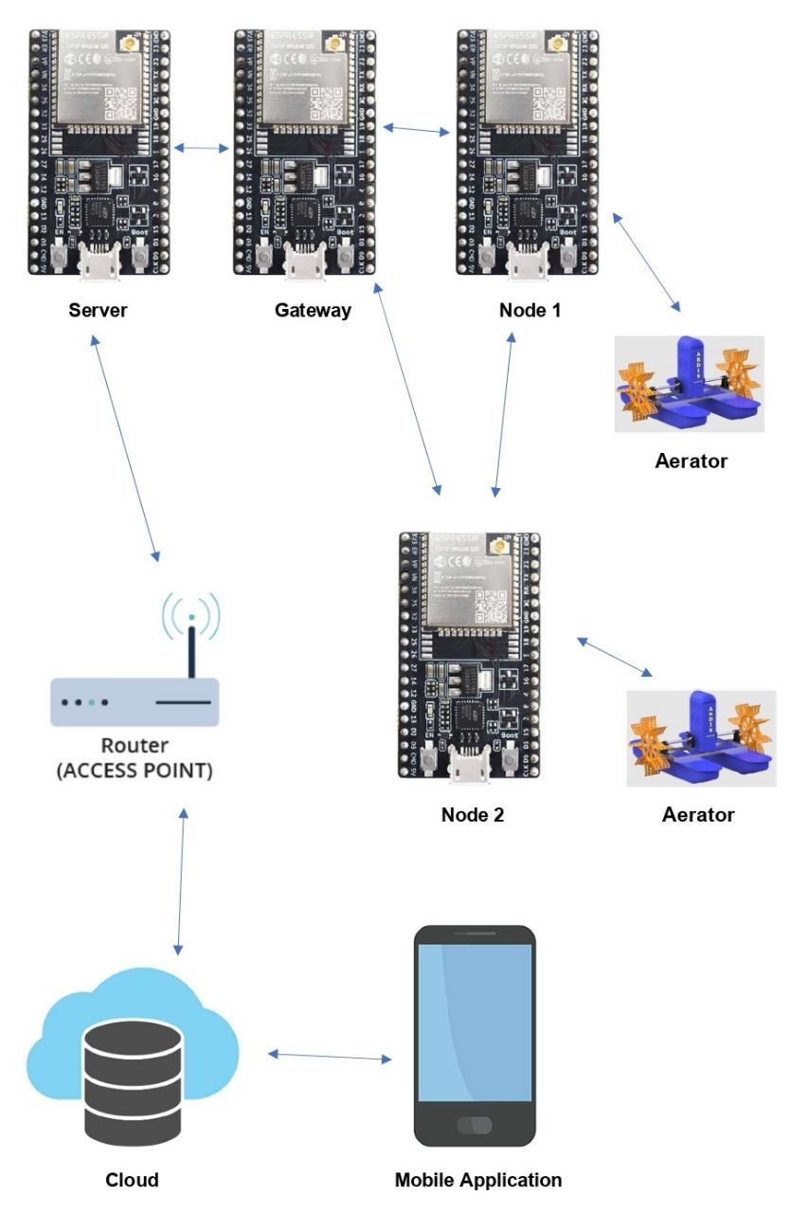
Block Diagram:

Slide 23
.
We propose to use ESP32 WiFi Module to control the relay which in turn controls the DOL Motor Starter.
This DOL Motor Starter will control a three phase motor which is used by the aerator.
ESP can travel over 100-150 meters in real world tests. Hence we will form a ESP Mesh Network to connect the various nodes that are present in the field

Slide 24
Mesh network will go through a gateway which is a ESP 32 gateway.
This gateway is connected to internet and will help to transmit and receive the data to the cloud.
ESP32 nodes in the mesh network will communicate with each other using ESPMESH Protocol.
It will transfer JSON data over the cloud using WebSocket or Rest API.

Slide 25
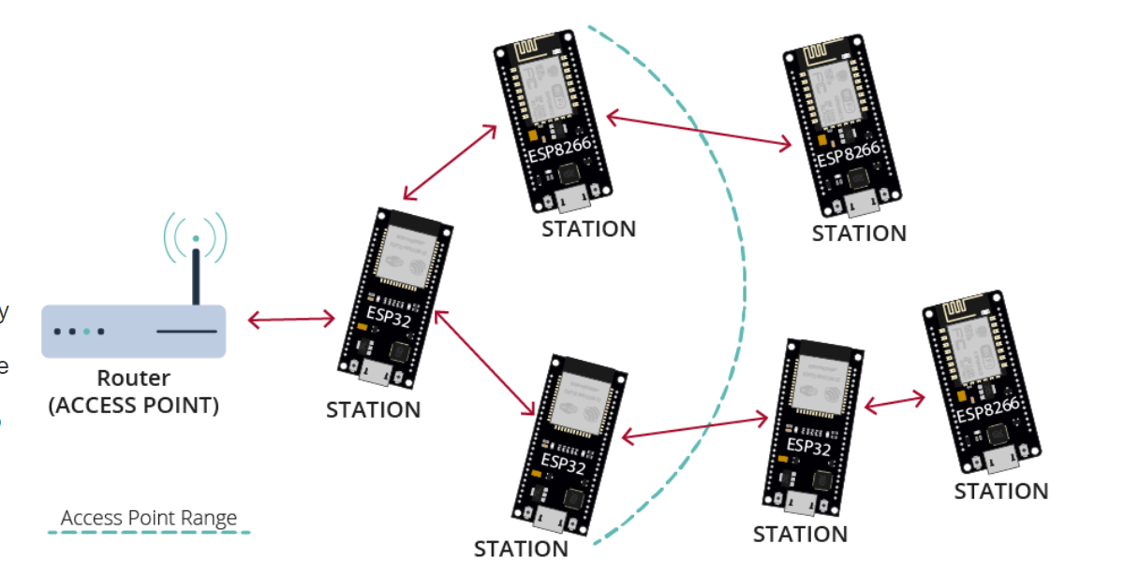

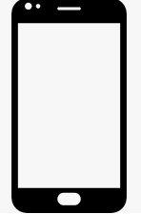
Cloud
Smartphone

Slide 26
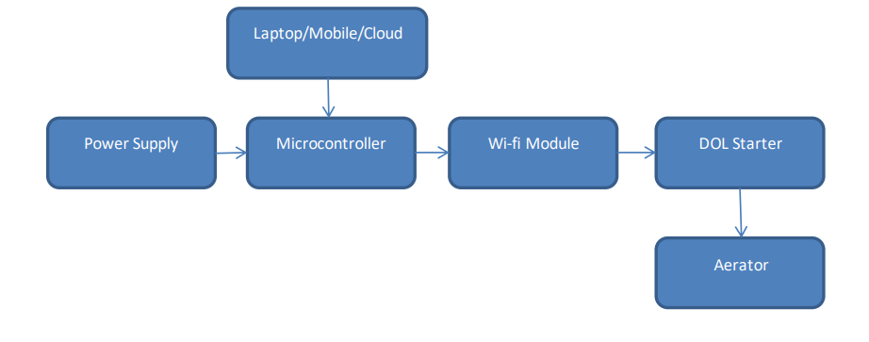
(5V 1A)
(Esp32)
(2.4A)
(2HP)

Slide 27
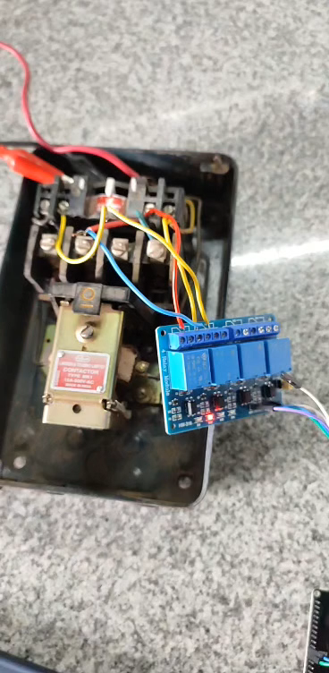

Slide 28
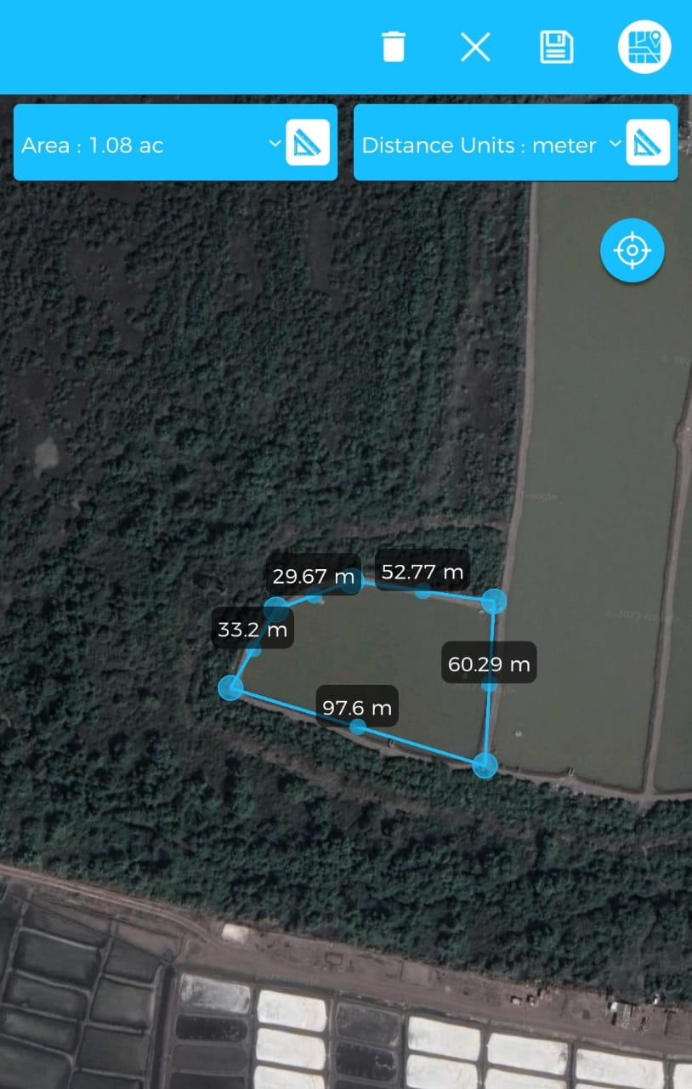
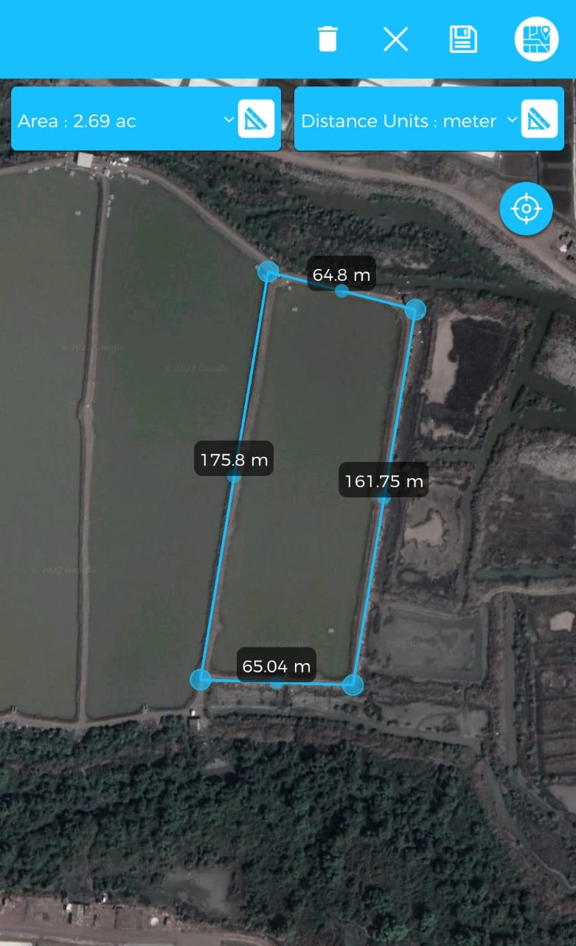

Slide 29
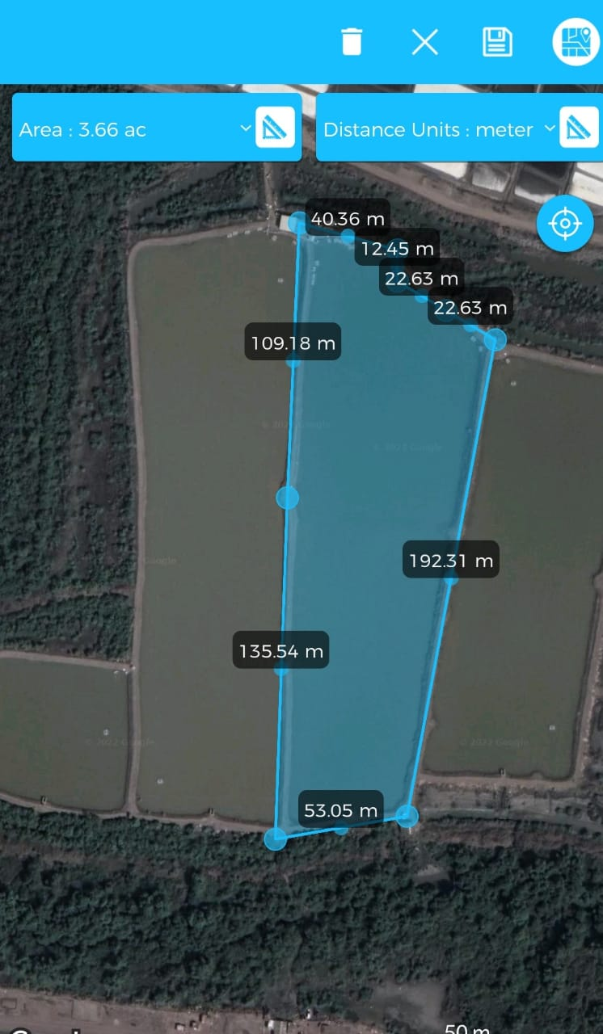
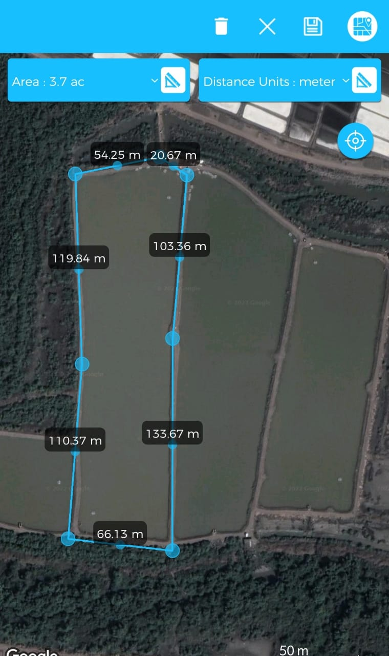

Slide 30
References:
[1] P. Udayan, K. Ants, N. Vilas, “Smart System for Automatic AC Motor starter based on GSM” IEEE, 2019 [Online].
[2] S. Harsh Kumar, V. Saurabh, P. Shashank, P. Kavita, “A step towards Home Automation using IOT” IEEE, 2019 [Online].
[3] F. Zhang, “Research on water-saving irrigation automatic control system based on Internet of things” IEEE, 2011 [Online].

Slide 31
THANK YOU

